Slide 1
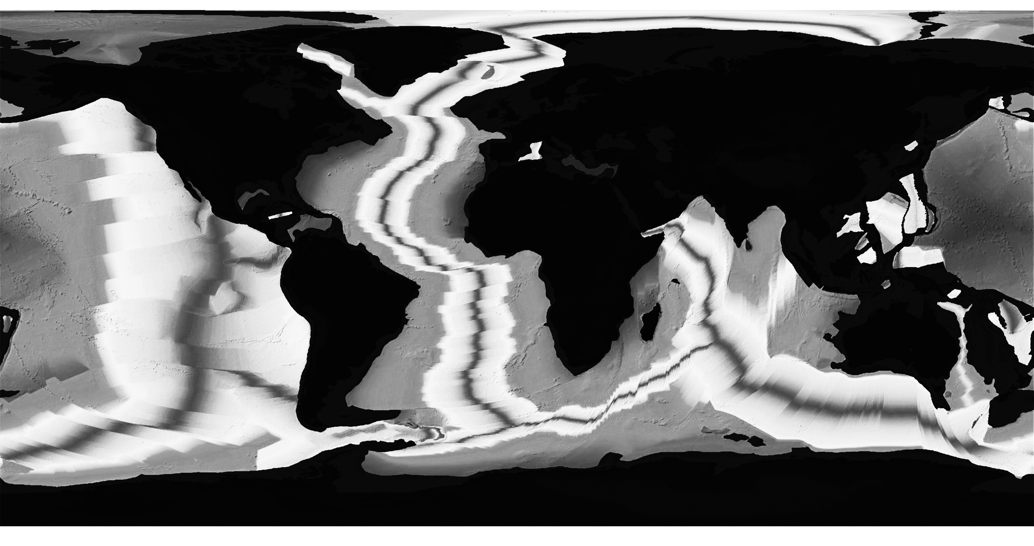
Age of Seafloor
✄
modified from http://www.cev.washington.edu/file/Age_of_Seafloor.html

Slide 2
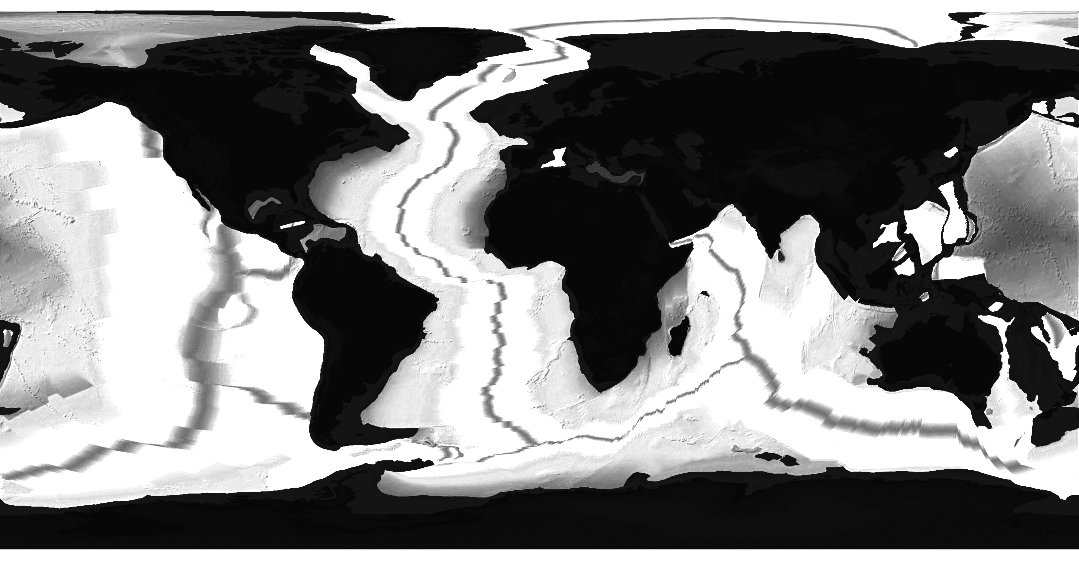
Age of Seafloor
✄
modified from http://www.cev.washington.edu/file/Age_of_Seafloor.html

Slide 3
⠠⠁⠛⠑⠀⠷⠀⠠⠎⠂⠋⠇⠕⠕⠗
✄

Slide 4
⠠⠁⠛⠑⠀⠷⠀⠠⠎⠂⠋⠇⠕⠕⠗
✄

Slide 5
✄

Slide 6
✄

